Slide 1
GAN-Based Architecture for Low-dose Computed Tomography Imaging Denoising
November 2025
PATURI SIVA PRASAD ( 20MIA1107)
KARTHIKEYAN A (23MIA1123)

Slide 2
Problem Statement
Low-dose CT scans are essential for reducing patient radiation exposure, but they suffer from high noise levels that degrade image quality. This noise obscures critical anatomical details, making diagnosis challenging. Traditional denoising methods often blur fine structures or introduce artifacts. There is a pressing need for intelligent, physics-aware denoising techniques that preserve diagnostic information while removing noise effectively. Our approach addresses this gap through deep learning-based denoising with superior fidelity and robustness.

Slide 3
Project Objectives
Develop a dual-head GAN architecture to simultaneously recover clean image content and estimate noise residuals. Improve PSNR and SSIM metrics by at least 10 dB and 10% compared to baseline methods. Preserve fine anatomical details such as vessel boundaries and tissue textures. Ensure the model generalizes well across different noise levels and patient types. Validate performance on real-world CT datasets with clinical relevance.

Slide 4
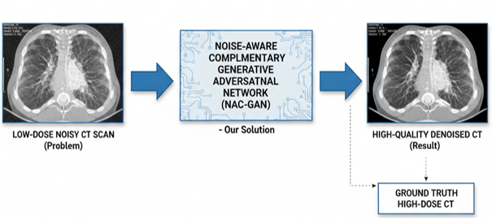
Clean Image Branch
Noise Estimation Branch
Dual-Head UNet Architecture: One branch reconstructs clean image, the other estimates noise residual. Both branches share early encoder layers for feature consistency.
Noise Residual Branch: Outputs pixel-wise noise map, enabling precise subtraction and refinement of noisy input.

Slide 5
Architecture Overview
Local Discriminator
Global Discriminator
PatchGAN (70×70) provides local perceptual consistency by evaluating small image patches. It ensures spatial coherence across regions with varying noise patterns.
Global Discriminator evaluates overall image structure and realism using scalar output. It prevents over-smoothing and maintains global anatomical integrity.

Slide 6
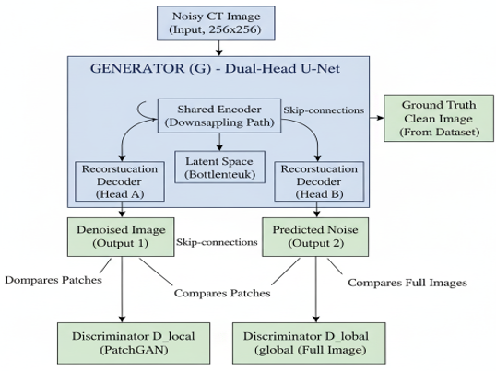

Slide 7
Loss Function Composition
Adversarial loss (0.1): Enforces realism via PatchGAN and Global discriminators. Content loss (10.0): Preserves structural features using L1 similarity to ground truth. Noise loss (5.0): Encourages accurate noise residual estimation. Orthogonality loss (1.0): Promotes independence between clean and noise branches to prevent information leakage. This balanced formulation ensures high-quality, artifact-free denoising while maintaining anatomical fidelity.

Slide 8
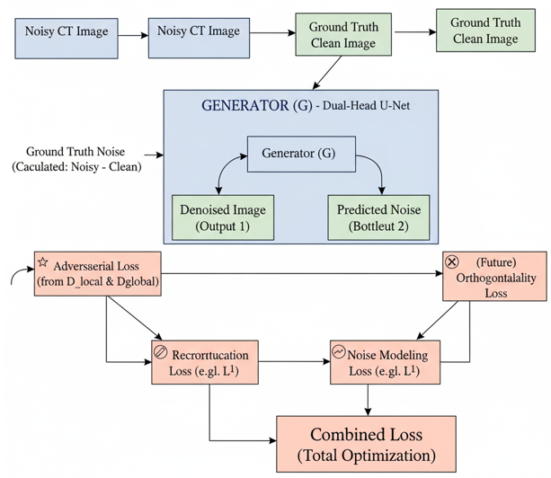

Slide 9
Dataset Details
3,684 CT slices from abdominal and thoracic scans, comprising 1,040 paired (noisy, clean) image pairs. Noise is added with Gaussian distribution σ = 0.05 to simulate clinical low-dose conditions. Data is split into 80% training, 10% validation, and 10% testing sets. All images are normalized to [0,1] range and resized to 256×256 for consistent input. The dataset covers diverse patient anatomies and noise patterns, ensuring robust generalization.

Slide 10
EVALUATION AND ANALYSIS
Quantitative Results
Visual Quality
PSNR improved from baseline (15.2 dB) to 28–32 dB (+13 dB), indicating significant noise reduction.
SSIM increased from 0.70 to 0.85–0.92 (+45%), showing better structural similarity and visual quality.
Visual inspection confirms sharpness of vessel boundaries, reduced graininess, and preserved texture in soft tissues.
Zoomed regions show no blurring or over-smoothing artifacts.

Slide 11
Performance vs. State-of-the-Art
Ablation Study
Our method achieves PSNR: 30.2 dB, SSIM: 0.90
RED-CNN: 27.2 dB, 0.83
WGAN-VGG: 28.5 dB, 0.85
Each component contributes meaningfully: Adversarial loss adds ~1.5 dB PSNR, content loss adds ~1.8 dB, noise loss adds ~1.2 dB, and orthogonality improves stability and convergence.

Slide 12
Conclusion & Future Work
The proposed dual-head GAN achieves superior denoising performance with improved PSNR and SSIM compared to existing methods. It preserves critical anatomical details, making it suitable for clinical use. The model reduces patient radiation exposure without compromising diagnostic accuracy. Future work includes training on real-world noisy data, moving to GPU acceleration, extending to 3D CT volumes, and exploring unsupervised learning for broader applicability. This work lays the foundation for AI-driven, low-dose CT reconstruction in clinical practice.

